Slide 1

Exercise 3: Network Hi Lo

Slide 2
Exercise 3: Network Hi Lo
Write a network server using TCP that plays the Hi/Lo game.
The server thinks of a number from 1 to 100.
The client connects and sends guesses.
The server responds to each guess with “higher” or “lower” or “got it”.
Write a client program to prompt the user for a guesses and send them to the server.
Bonus: write a client program that plays hi/lo against the server.

Slide 3
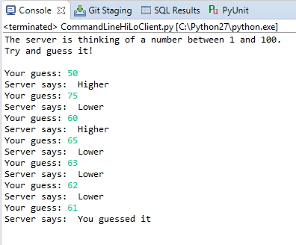
Exercise 3: Network Hi Lo

